Slide 1

DAYANANDA SAGAR COLLEGE OF ENGINEERING
DEPARTMENT OF ELECTRONICS AND COMMUNICATION
Mini Project Work (18EC6ICMPR )
Presentation on
AUTONOMOUS FLOOR CLEANING ROBOT
Under the guidance of Dr. K P Shashikala Prof, Dept. of ECE
By:
BATCH NO. - B16
1DS18EC083 Sharanya S
1DS18EC085 Shashidhar T
1DS18EC090 Spoorthy M K
1DS18EC097 Vanishree G B

Slide 2

1. Introduction
2. Objective
3. Literature survey
4. Problem Statement
6. Bot working
7. Conclusion
8. Future scope
9. References
5. Block diagram and Implementation
CONTENTS

Slide 3
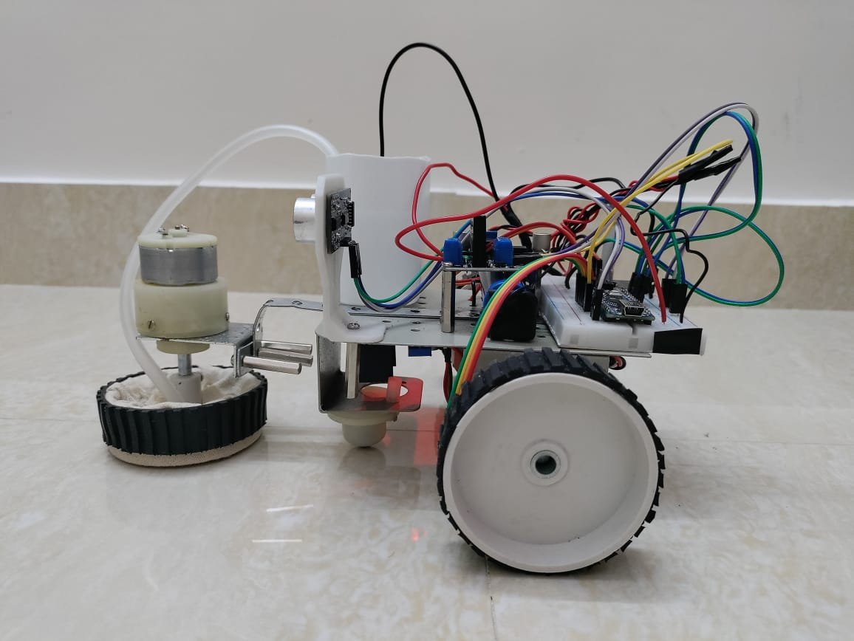
INTRODUCTION
Robotic cleaner is an electromechanical machine used
for various purposes in domestic applications.
Automatic floor cleaners on the market share a common
problem that they are too expensive for what they do.
The Autonomous Floor Cleaning Robot that costs a
small fraction of the ones in the market.
The Robot can detect the wall and objects in front of it and can continue moving, avoiding the obstacles, until the whole room is cleaned.
The autonomously working floor-cleaning robot will make mopping operations more efficient and easy which also reduces the cost of cleaning and human efforts.
It is been designed for consumer, office environments, educational institutions and is able to do the whole cleaning process automatically.

Slide 4
OBJECTIVE
Able to solve the problems of conventional floor cleaning mops that cannot be used and moved independently which consumes a lot of electric power.
To require low maintenance, easy to operate, low cost
To help working in human hazard places such as nuclear plants, chemical industries and to skip need of personnel.
To design a robot with Microcontroller, Ultrasonic sensor, Bluetooth module, DC motor and mopping mechanism to complete the complex task of cleaning and improve the cleaning performance.

Slide 5
LITERATURE SURVEY
Vinod J Thomas has designed a cleaner robot for domestic application.
Capable of reaching almost every space and corner of any room.
Handled using an Android phone using Wireless Bluetooth Technology.
Complemented with communications modules like Wireless Bluetooth motors and dirt Suction System.
S Monika, K Aruna Manjusha presents that floor cleaning is worn out a neater way and efficiently by robot utilizing wireless system.
Previous research papers like robot household appliance and automatic floor cleaner robot had some drawbacks like colliding with objects before of it and this vacuum couldn’t reach to small areas and left those areas unclean.
The automatic floor cleaner robot collects the dirt.
The downside up here is that it doesn't clean the wet floor.

Slide 6
LITERATURE SURVEY
Karthick.T is intended to create an autonomous automatic robot which will move itself without constant human instruction.
The autonomous cleanser robot involves low power consuming electric components.
Electric parts are the controller board Atmega , Ultrasonic detectors, transformer IC and motor driver circuit.
A 12V, 4.5Ah rechargeable lead acid electrical device is the energy source for this cleaning automatic robot.
Zelun L, Zhicheng Huang designed a cleaning automatic robot predicated on the ultrasonic basics.
The robotic can do the characteristic of practical impediment avoidance, programmed manage and programmed sweeping.
A revolving cylindrical brush is used before the automated robot and it sweeps garbage into the dustbin along the way of motion.
A mop is also used behind the automated robot which can sweep the ground when the automated robot is functioning.

Slide 7
LITERATURE SURVEY
Rupinder Kaur designed a swabbing automatic robot which is extremely good for cleaning jobs especially in homes, Office buildings, Industries.
Artificial intellect could be a branch of technology which makes computers sounds like mind.
This product will sweep, and mop the bottom area with clean and other wiping components.
It collects the dust particles and other small parts in it.

Slide 8
PROBLEM STATEMENT
People in urban have abnormal and long working hours. In such a situation an individual will always find ways of saving time.
Difficult to clean the inaccessible areas like underneath of sofa, bed and table and pick small particles.
Normally floor is cleaned with the utilization of dry mopped or wet mopped using hand as a base tool and they need to be scrubbed hard on the surface.
The cleaning module includes cleaning of varied surfaces like cement floors, highly polished wooden or marble floors.
The rough surface areas like cement floor are covered with heavy dust which consumes longer in cleaning.
Difficult to work in human hazard places such as nuclear plants, chemical industries etc

Slide 9
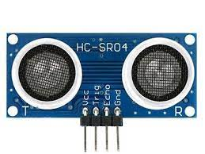
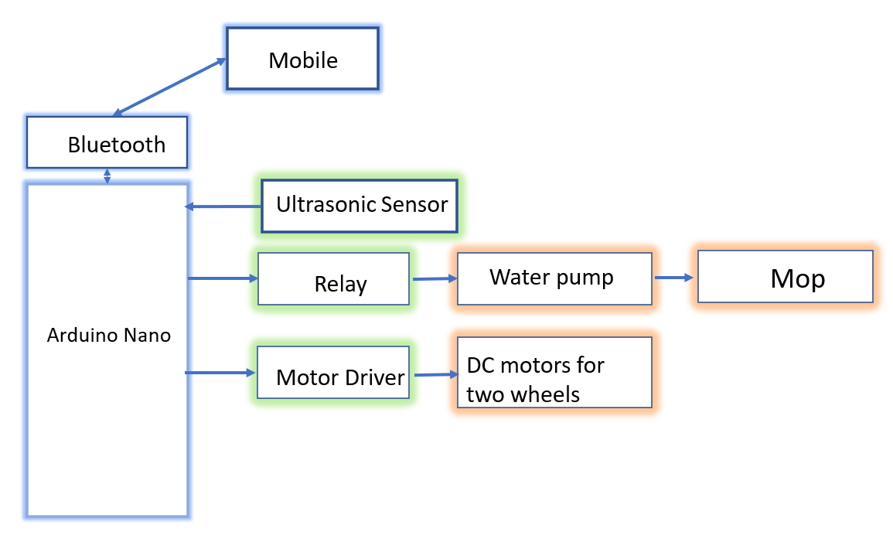
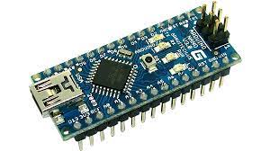
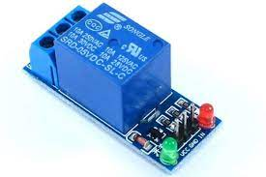
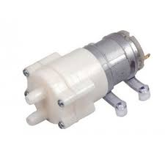
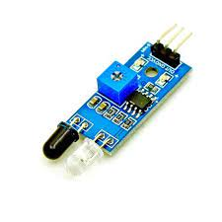
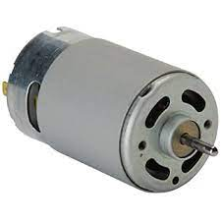
BLOCK DIAGRAM AND IMPLEMENTATION

Slide 10
Arduino Nano
The Arduino Nano is a small, complete, and breadboard-friendly board based on the ATmega328 .
14 digital I/O pins.
Works with a mini-B USB cable instead of a standard one.
Operating voltage is 7-12V.
Power consumption is 19mA.

Slide 11
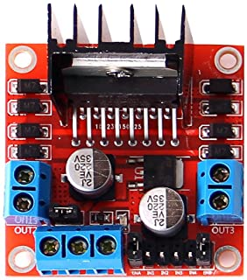
L298N Motor driver
L298N is a dual H-Bridge motor driver which allows speed and direction control of two DC motors at the same time.
L298N consists of two H-bridge. H-bridge is the simplest circuit for controlling a low current rated motor.
Driver Voltage: 5-35V
Driver Current: 2A

Slide 12
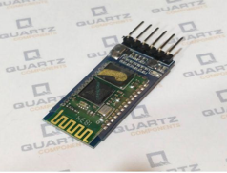
Bluetooth Module HC-05
HC-05 is a Bluetooth module designed for wireless communication.
Works on 3.3V.
Can also be connected to 5V supply since the module has on board 5 to 3.3V regulator.
Has two modes:
1. Data mode: Exchange of data between devices.
2. Command mode: To change settings of HC-05.

Slide 13
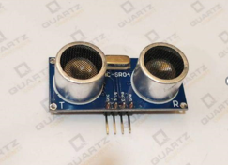
ULTRASONIC SENSOR HC-SR04
4 pin module, Vcc, Trigger, Echo and Ground.
Provides 2cm to 200cm of non contact measurement functionality.
It is mainly used to determine the distance of the target object.
Using the sensor for wall detection in the project.

Slide 14
Relay Module
Electrical switch operated by an electromagnet.
Basic function of relay is to control one electrical circuit by opening and closing contacts in another circuits.

Slide 15
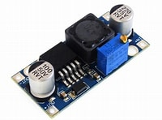
DC to DC Converter (LM2596)
An electronic circuit that converts a source of direct current (DC) from one voltage level to another.
It can convert the voltage from 3V to 40V.

Slide 16
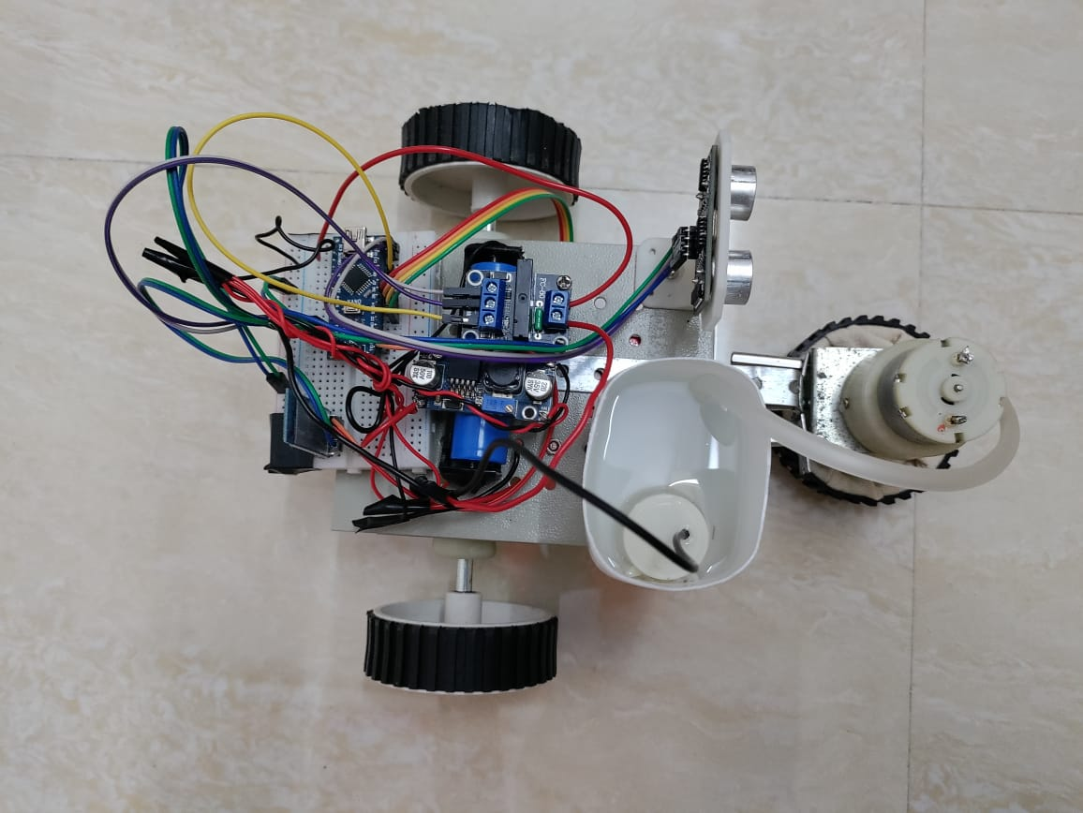
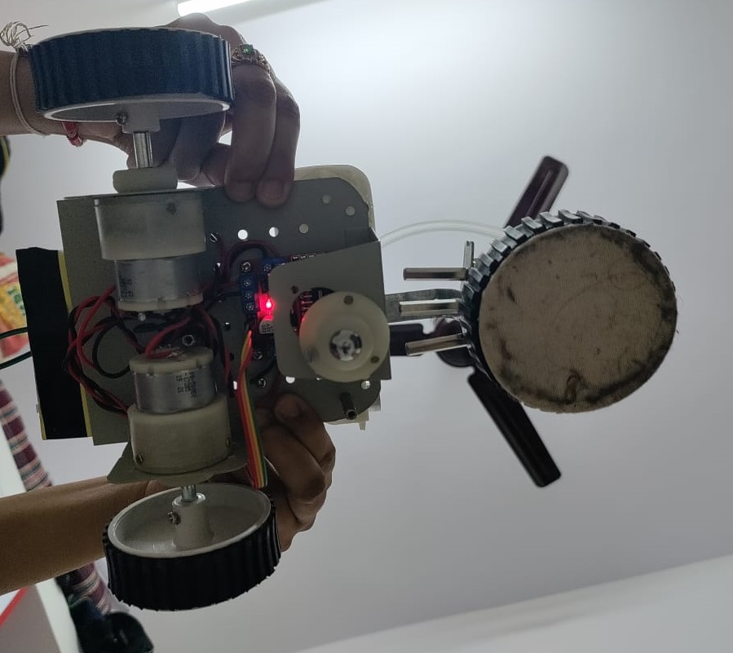
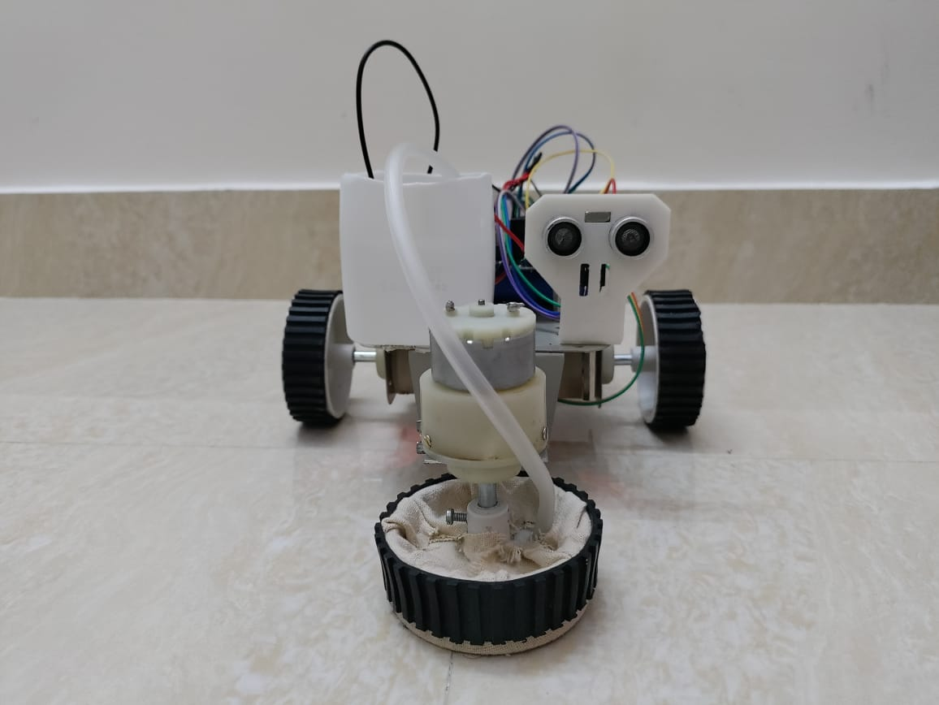
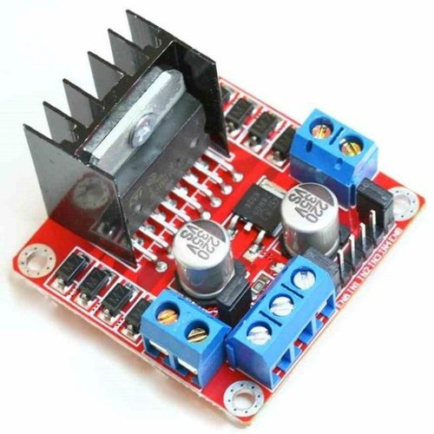
BOT

Slide 17
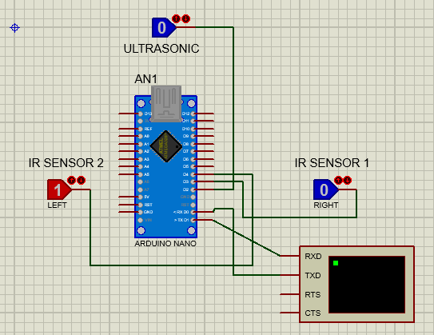
CIRCUIT

Slide 18
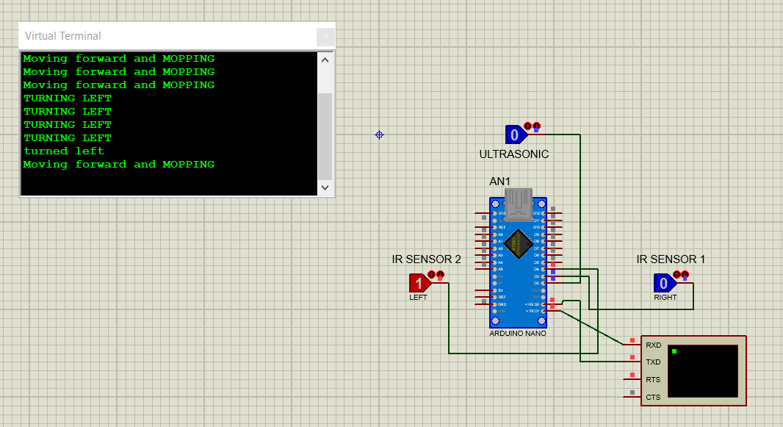

Slide 19
SOFTWARE
If the robot is at right end corner of the room, IR1 turns high and robot starts moving straight and mopping.
If the ultrasonic sensor detects the wall or obstacle, it turns high and starts turning to the left.
When both IR1 and ultrasonic sensor turns low and IR2 turns high, the robot turned left and starts moving straight and the loop continues.

Slide 20
BOT WORKING

Slide 21
CONCLUSION
This project helps to design and development of Autonomous floor cleaning robot.
This concept has been to be an efficient way of saving time and helping physically disabled people.
As specified the user can switch on the device and go for any other work and the robot will automatically mop the floor by detecting and avoiding the obstacles on its way.
The structure of the robot can be made more attractive for better acceptance at home or office environments.
It is dependent on DC power supply and favourable for battery, especially for long operation and cost-effectiveness.
The straight motion occurs when the robot encounters the walls or other objects. The estimated cost of equipment is INR 5000.

Slide 22
FUTURE WORK
GSM modules can be added to the domestic robots making them easy to operate and accessible.
Obstacle detection can be developed with the help of Image Processing and Machine learning concepts.
The camera and 2D mapping can be added on robot.
The mapping and obstacle avoidance could have been well served with a 180 degree LIDAR sensor.
The chassis can be built on a PVC polymer.
Germ less cleaning using UV exposure can be installed on the system.

Slide 23
REFERENCES
[1] V. J Thomas, B. Xaviour, J. K George, “Cleaner Robot”, International Journal of Emerging Technology and Advanced Engineering, ISSN 2250-2459, ISO 9001:2008 Certified Journal, vol. 5, no. 12, 2015.
[2] K. Rupinder, “An extremely cost efficient Swabbing Robot”,International Journal of Engineering and Computer Science ISSN: 2319-7242, vol. 6, no. 1, 2017.
[3] S Monika, K Aruna Manjusha, S V S Prasad, B.Naresh “Design andImplementation of Smart Floor Cleaning Robot using Android App”International Journal of Innovative Technology and ExploringEngineering (IJITEE) ISSN: 2278-3075, Volume-8 Issue-4S2 March,2019.
[4] Zelun L, Zhicheng Huang, “Design of a type of cleaning robot withultrasonic”, Journal of Theoretical and Applied Information Technology31st January 2013. Vol. 47 No.3, ISSN: 1992-8645
[5] Rupinder, “An extremely cost efficient Swabbing Robot”,International Journal of Engineering and Computer Science ISSN: 2319-7242, vol. 6, no. 1, 2017.

Slide 24

THANK YOU

